Slide 2
Cloud Native Storage CubeFS, Empowering AI Acceleration
Hu Yao，oppo

Slide 3
CubeFS Introduction
The Requirements and Challenges of LLMs Storage
OPPO LLM Storage Practices Based on CubeFS
CubeFS Future Plans

Slide 4
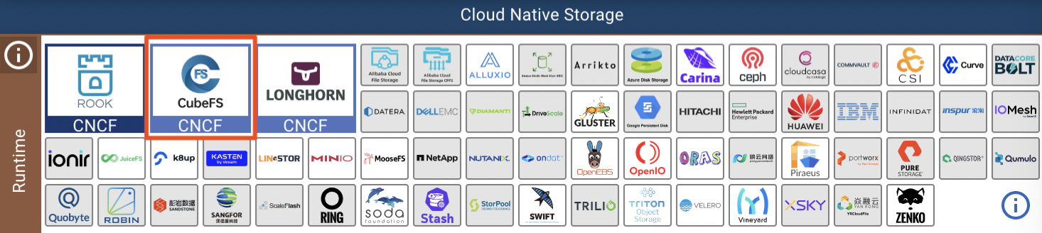
CubeFS Introduction
CubeFS is a new generation of cloud-native open-source storage
hosted by the CNCF，Currently in the "incubating" stage , and progressing towards "graduation".
the first product that provide a complete set of file and object storage capabilities.
Official website: https://cubefs.io.

Slide 5
CubeFS Development History
Launching
Reinforcement
Ready to graduate
Mar: StabilityEnhanced
Oct: Remote shuffle
Mar: audit log and stability
Aug: atomicity, stability
quota limitation
Security audit ongoing
Mar: opensource
Dec: Join CNCF Sandbox
2019
2020
2021
2022
2023
In Progress
Big Leap
Apr: S3 interface
Aug: hdfs sdk
Jan: Failure domain group
Apr: Erasure-code
Jun: Incubation project
Aug: QoS & Cache acc

Slide 6
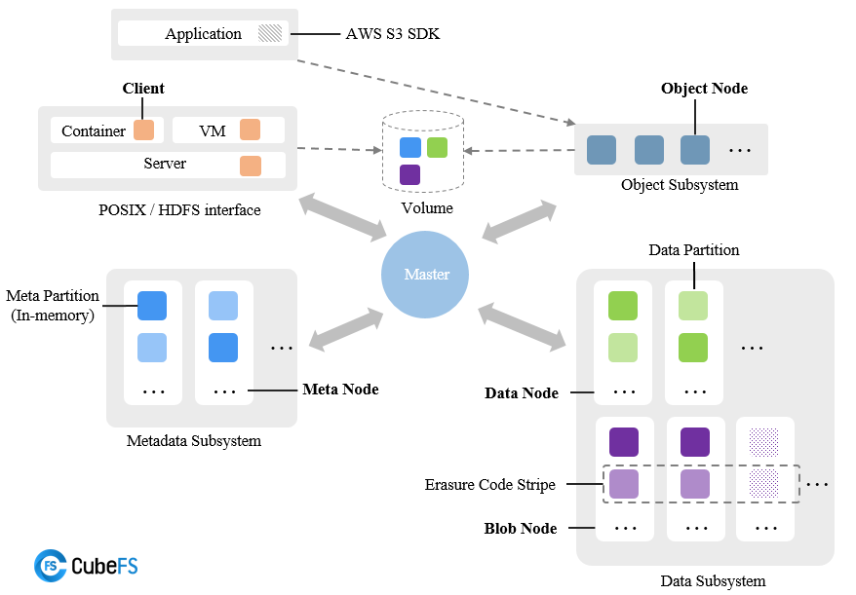
Key Features
Key Features
Multi-protocol Access interoperability
Replicates / Erasure-coding engine
Multi-tenant Management
Multi-level Caching Acceleration
High Scalability
High Performance
Cloud Native

Slide 7








Multi-protocol Client
Multi-Protocol Client /SDKs
S3, POSIX, and HDFS protocols compatibility
Multiple protocols share the same set of
metadata and data
Multi-engine analysis of data without copying
Mixed data workload improves storage utilization
Past
S3
HDFS
POSIX
IOT
Spark
Tensorflow
image&text
Flink
Pytorch
Audio&video
Trino
PaddlePaddle
S3
HDFS
POSIX
Now

Slide 8
MetaData Subsystem
Scalability: Managing the volume directory tree through metadata sharding technology.
Strong Consistency: Ensuring high availability and strong consistency of MP through the Raft algorithm.
Reliability: MP data is persistently stored on disk through Snapshot+Raft log mechanism.
High Performance: MP is fully cached in memory
for lightning-fast access.
Root
Secondary Index
<parent_id, name>→inode
inode→location
/
a
b
c
d
e
mp0
mp0
mp0
multi-raft
Meta Partition(MP)
mp1
mp1
mp1
…
Meta Node(MN)
mp2
mp2
mp2
…
…
…
…
MetaData Subsystem

Slide 9
Data Subsystem : Replicates
Replica Engine
Multiple Replication Protocols: Sequential writing adopts NRW, while random writing adopts the Raft protocol.
Optimization for Large and Small Files: Large files are stored in shards, while small files are stored in an aggregated manner.
Efficient Reclamation Mechanism: Utilizes the file system's punch hole mechanism to enhance the efficiency of recycling deleted space.
DataNode
DataPartition
Sequential Write
Sequential Write
DataNode
Random Write
DataNode
DataPartition
DataPartition
multi raft
DataPartition
Large File
Sharding
Small File Aggregation

Slide 10
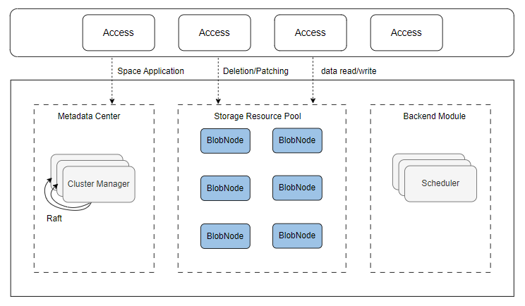
Data Subsystem : Erasure Coding
Online Erasure-Coding Engine
Access Layer
Resource Management and Scheduler
Storage Resource Pool

Slide 11
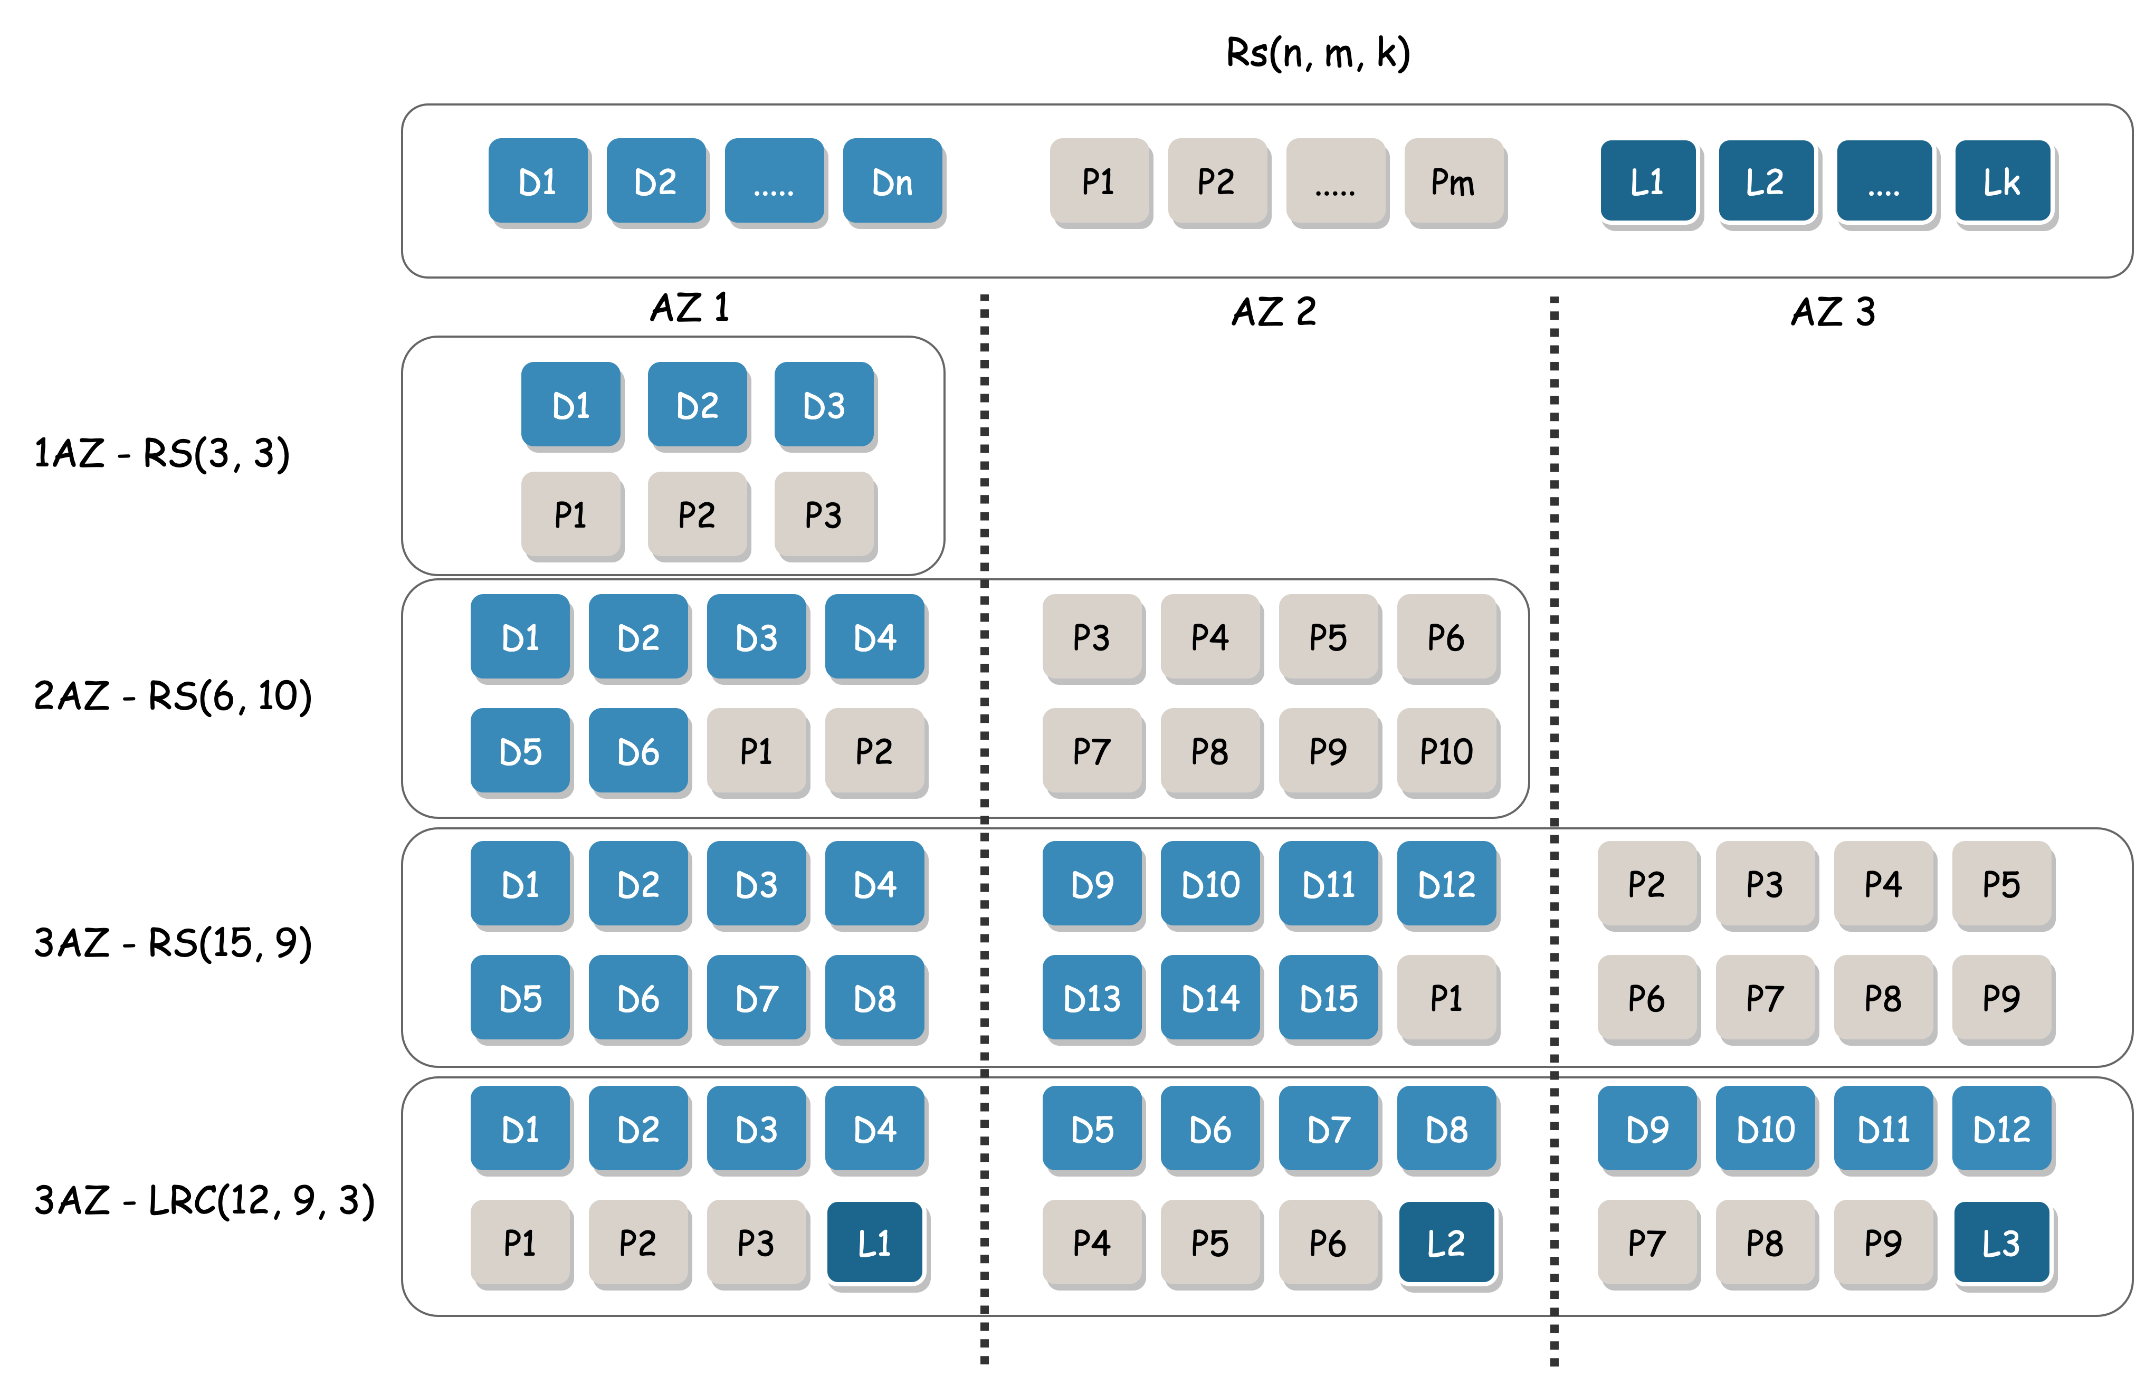
Data Subsystem : Erasure Coding
Low-cost erasure coding engine
Online EC encoding/decoding
Striped EC
Support for multi AZ deployment
Support for multiple encoding modes
Fault self-healing
Automatic inspection and repair (disk, stripe)
Automatic repair

Slide 12
CubeFS Introduction
The Requirements and Challenges of LLMs Storage
OPPO LLM Storage Practice Based on CubeFS
CubeFS Future Plans

Slide 13
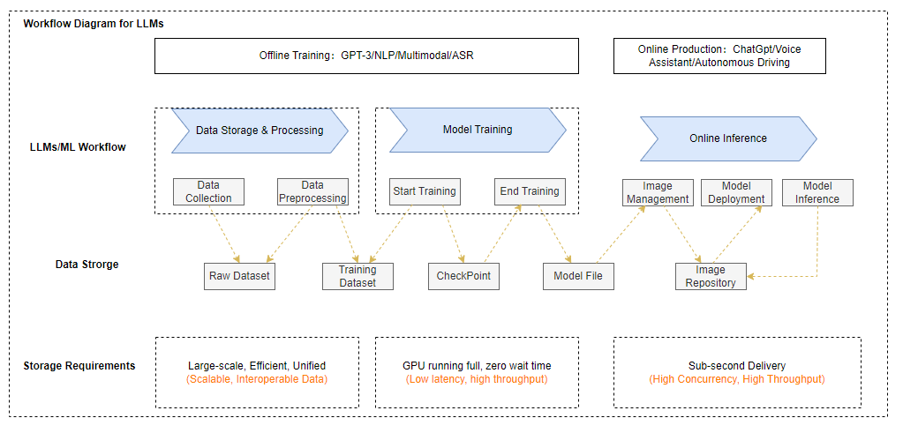
Storage requirements for LLMs

Slide 14
Storage challenges of LLMs
Efficient data flow across different stages.
Accelerating file access during training.
Efficiently saving checkpoint intermediate results during training.
High availability, high Concurrency, high Throughput.
Low cost, no data loss.

Slide 15
CubeFS Introduction
The Requirements and Challenges of LLMs Storage
OPPO LLM Storage Practice Based on CubeFS
CubeFS Future Plans

Slide 16
Evolution history of AI storage in OPPO
Multi-Tier Cache
2019
2020
2021
2023
CephFS Storage
CephFS & CubeFS
CubeFS
CubeFS &
Multi-Tier Caching

Slide 17
CephFS Storage Stage
MDS Performance Bottlenecks:
The primary-secondary mode of MDS does not support horizontal scaling.
MDS Stability:
Out of memory (OOM) error occurred while traversing a large directory.
root
dir1
dir2
dir3
Large directories
sub1
sbu1
…
…
sub2
Large directories
MDS1
MDS2
MDS3

Slide 18
Coexistence period of CubeFS and CephFS
Multi-Cluster:
Splitting a large CephFS cluster into multiple smaller clusters.
Small Cluster:
The small cluster is stable but has low resource utilization.
CV
NLP
Audio
…
Others
Kubernetes
Monitoring
GPU
GPU
GPU
GPU
Permission
Alerts
......

Slide 19
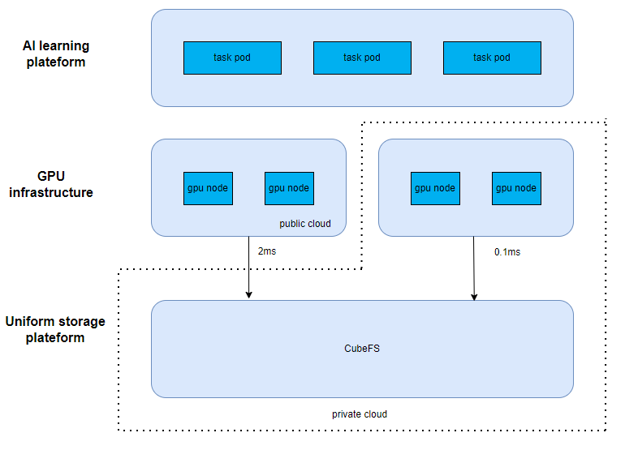
CubeFS Unified Storage
Hybrid cloud demand
Private cloud provides foundational computing power
Public cloud offers elastic computing power
Pain points of hybrid cloud
Public cloud has high dedicated line latency
Poor access performance

Slide 20




The Pain Points of AI in Practical
Latency-Sensitive
Large Directoriy
Poor Performance in Hybrid Cloud
Hotspot Directoriy

Slide 21
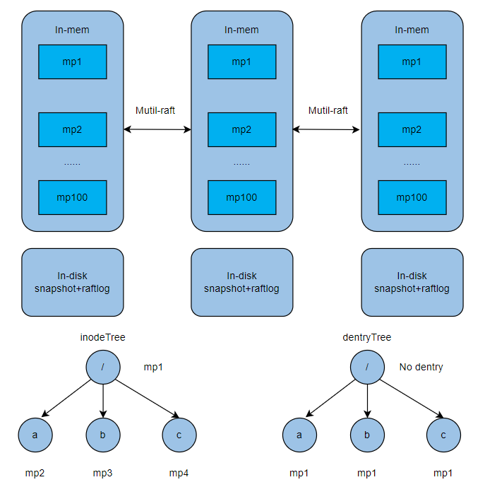
High-performance and scalable metadata
Metadata is persisted to disk and cached in memory
File's dentry and inode sharding by range
Efficient readdir performance
Tens of millions files in a single directory
Tens of billions of files in single cluster

Slide 22
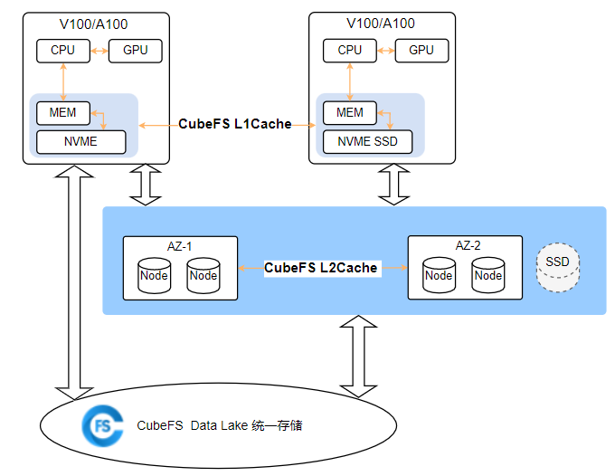
Multi-level Cache Acceleration
Cache Acceleration
Two-level Cache
Local
Global
Cache Policy
Active Pre-warming
Passive Caching

Slide 23
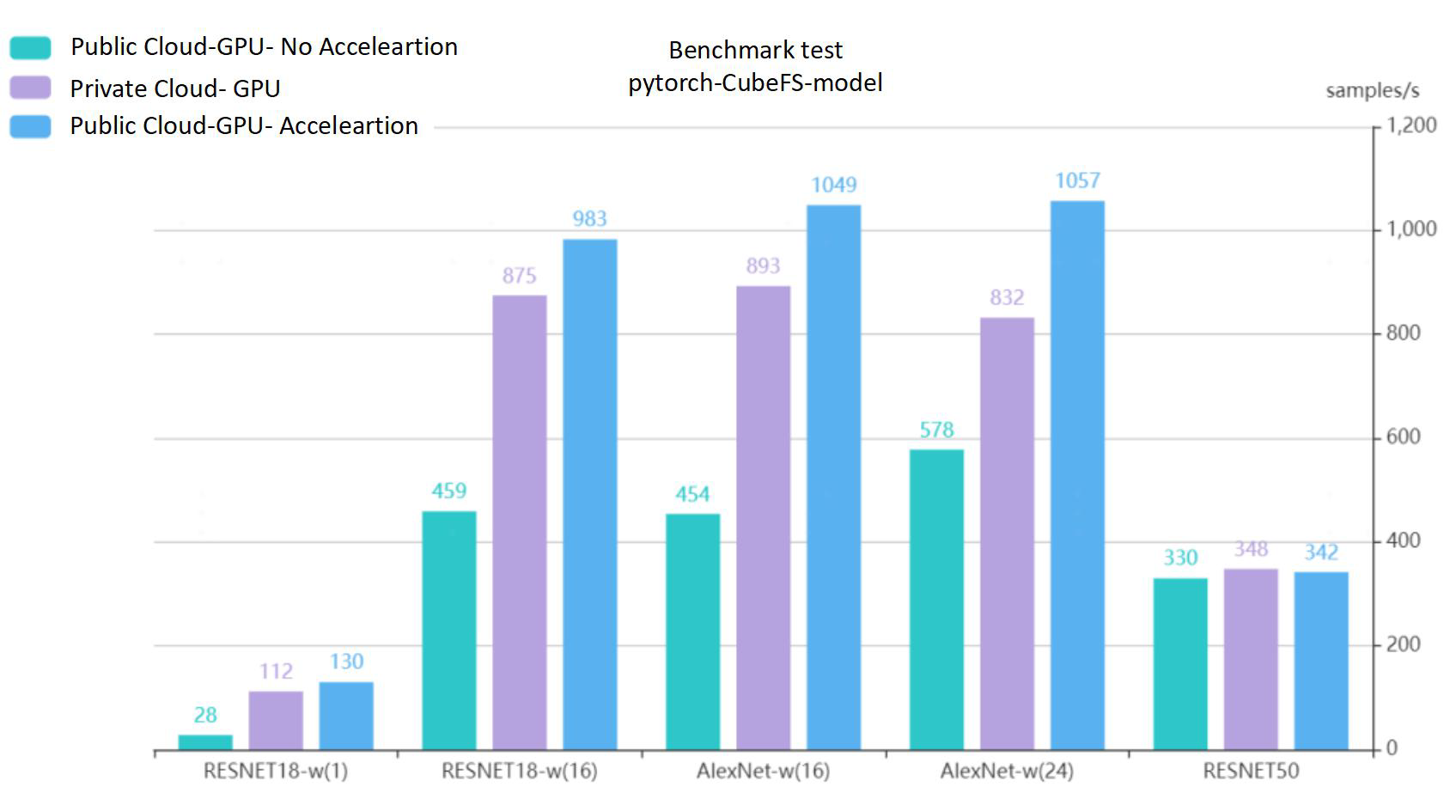
Benefits of Cache Acceleration

Slide 24
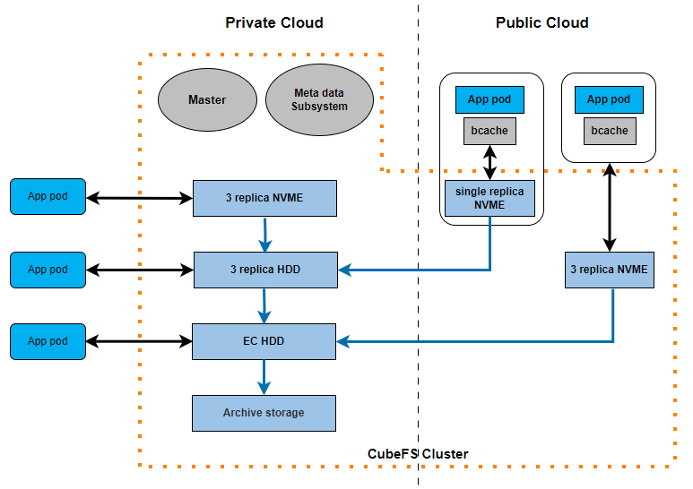
New Hybrid Cloud Solution
The concept of hybrid
Mixing multiple types of storage resources within a Cluster
Cross-Cloud Hybrid storage of persistent data resources within a Cluster
Intelligent Data Tiering
Volume-level tiering policys with file-level tiering actions.
Driven by lifecycle mechanism
If the cache miss, data will be read from the lower layer and asynchronously written to the cache

Slide 25
CubeFS Introduction
The Requirements and Challenges of LLMs Storage
OPPO LLM Storage Practice Based on CubeFS
CubeFS Future Plans

Slide 26

Future Planning
Application
Performance
Optimization
Ease-of-Use
CubeFS for Andriod
GDS
Dynamic Metadata
Cache
Dashboard 2.0
Hybrid/Multi Cloud
Kernel Client
Replica and EC Subsystem Merging
Official Website 3.0
Vector Retrieval
RDMA
Meta Subsystem Reconstruct
Migration Toolchain

Slide 27

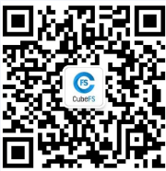
Learn more
website： https://cubefs.io
github： https://github.com/cubefs
slack: https://cubefs.slack.com
Official public account
WeChat Assistant

